Slide 1
Text Classification using RNN

Slide 2
Content Layout…
Abstract
Analysis of main idea
Why RNN?
Related work
Implementation
Findings and results
Conclusion

Slide 3
Abstract
In this project, we develop an RNN models for the task of text classification on the AG news dataset which consists of news articles, which are divided into four categories: business, science and technology, sports, and world.

Slide 4
Analysis of main idea
The main idea of this project is to evaluate the effectiveness of Long Short-Term Memory (LSTM) networks and Gate Recurrent Unit (GRU) networks for the task of text classification.

Slide 5
Why RNN instead of CNN for text classification?
CNNs are commonly used for image classification tasks. They are not as well-suited for text classification tasks. This is because the structure of text data is very different from that of images. Text is sequential and ordered, while images are grid-like and unordered. Therefore, the techniques that work well for image data, such as convolution and pooling, are not as effective for text data.

Slide 6
Why RNN instead of CNN for text classification?
RNNs are specifically designed to handle sequential data and process the context of a word in relation to the words before it, which is important in NLP tasks like text classification. They are able to capture long-term dependencies in the data .This makes RNNs a more natural choice for text classification tasks due to the unique properties of text data.

Slide 7
Related work
Meng et al (2020). present the LOTClass model, a label-name-only text classification approach that is built by define a category vocabulary for each class. LOTClass has been 0.864 accuracy without learning from any labeled data. It only requires the use of at most 3 words per class (and often only 1 word per class) as the label name.
Nyandwi, J. Designed long short-term memory model to classify the ag news into four categories, and he tried a classical model and another one with more stacked LSTM layers in addition to Gate Recurrent Unit model (GRU). He got an accuracy 0.897 in LSTM model.

Slide 8
Dataset
The dataset used is the AG news dataset (Zhang et al, 2015) which is a large collection of news articles from various sources, totaling more than one million articles. It is widely used for text classification tasks. The dataset is divided into four categories: World, Sports, Business, and Science and Technology.

Slide 9
AG news dataset

Slide 10
Implementation
In order to use this dataset for machine learning purposes, we first preprocessed the data by converting all text to lowercase and removing punctuations, digits, non-word characters, extra spaces, contraction, and stop words, finally stemming the words using Porter stemmer. We then split the preprocessed data into three sets: a training set, a validation set, and a test set.

Slide 11
Implementation
We first used a tokenizer to convert the text into sequences of integers. This process allows us to represent the text as a series of integers and ensured that the input data had a consistent shape, which can be input to the model. We then used the pad sequences function from Keras to standardize the length of the sequences. This is necessary because the RNN model expects input data to have a fixed shape.

Slide 12
Implementation
The code defines an LSTM model using the Keras API. The model consists of the following layers:
An embedding layer: This layer converts the input data, which is a sequence of integers representing the words in the text, into dense vectors of fixed size.
Bidirectional LSTM layers: These layers are responsible for processing the input data and capturing long-term dependencies in the sequences.
A global max pooling layer: This layer reduces the dimensionality of the data by taking the maximum value over all the time steps in the input sequence.
Fully connected (dense) layers: These layers apply a non-linear transformation to the output of the previous layer and generate the final predictions.
An output layer: This layer has four units, corresponding to the four categories in the dataset, and a SoftMax activation function, which converts the outputs to probabilities.

Slide 13
Implementation
The other model is GRU consists of the following layers:
• Embedding layer: This layer maps the input data into dense vectors of fixed size.
• GRU layers: It uses gating mechanisms to control the flow of information. The dropout and recurrent dropout arguments are regularization techniques used to prevent overfitting.
• Output dense layer: This is the output layer with 4 units and a SoftMax activation function. The SoftMax function maps the outputs to a probability distribution over the 4 classes.

Slide 14
Accuracy score on test set for all mentioned approaches
Method | Accuracy on Test data
LOTClass (Meng et al., 2020) | 0.864
LSTM (Nyandwi, J) | 0.8974
GRU (Tomeh, L) | 0.8732
LSTM (Tomeh, L) | 0.905

Slide 15
Loss and Accuracy for three sets
 | LSTM |  | GRU
Dataset | Loss | Accuracy | Loss | Accuracy
Training data | 0.228 | 0.929 | 0.352 | 0.884
Validation data | 0.299 | 0.904 | 0.384 | 0.874
Test data | 0.305 | 0.905 | 0.381 | 0.8732

Slide 16
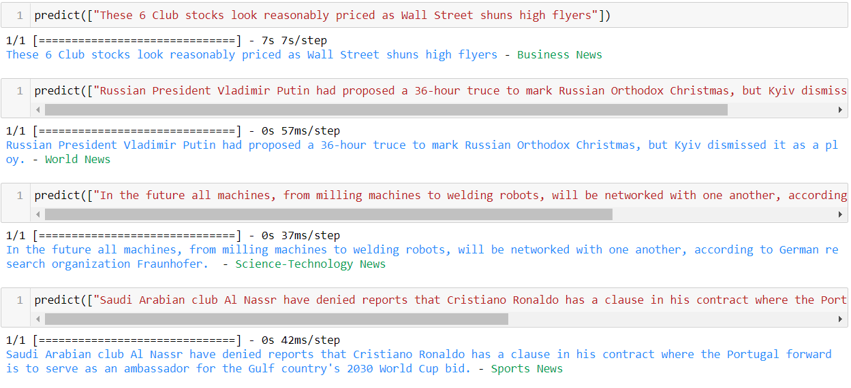
Findings and results …

Slide 17
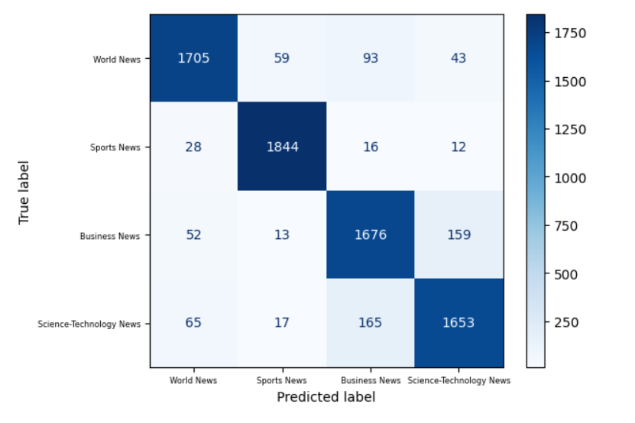
LSTM

Slide 18
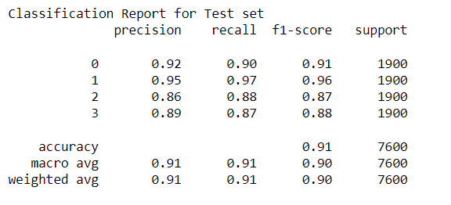
Classification report of test data

Slide 19
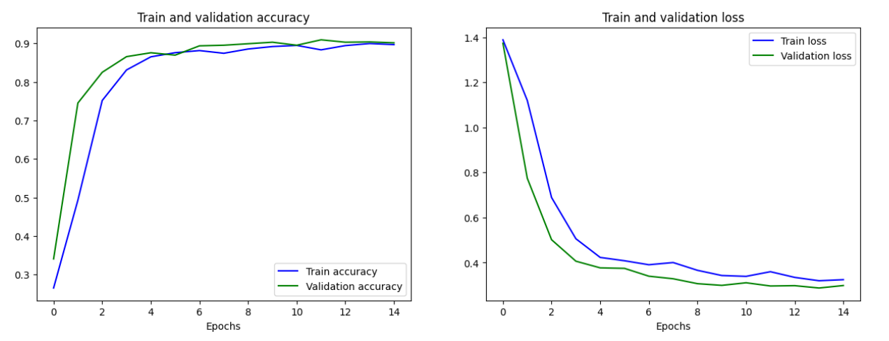

Slide 20
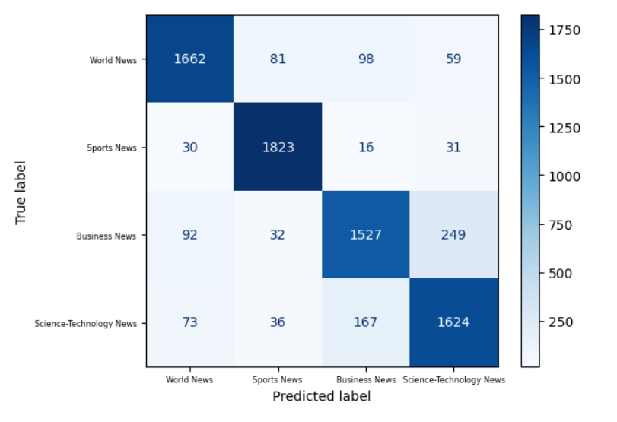
GRU

Slide 21
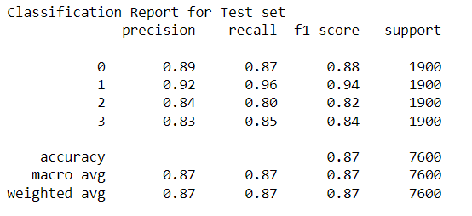
Classification report of test data

Slide 22
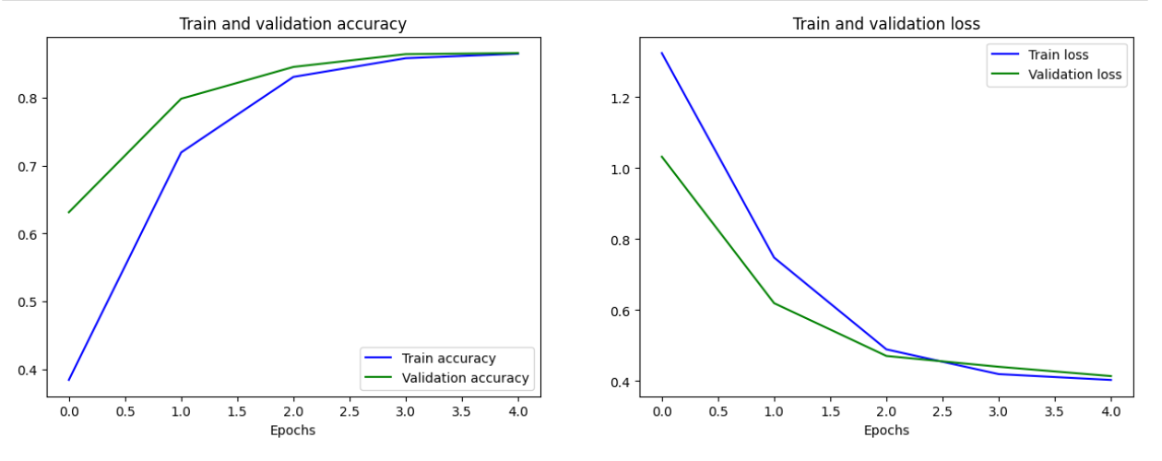

Slide 23
Conclusion
Overall, the process of creating and training an RNN model for the Ag News dataset was successful. The LSTM model achieve a high level of accuracy and could potentially be used for further analysis or classification tasks in the related fields. These results suggest that LSTM networks are a promising approach for text classification tasks, while the GRU model requires massive computing power, takes longer time, and produces less quality results than the latter.

